Slide 1
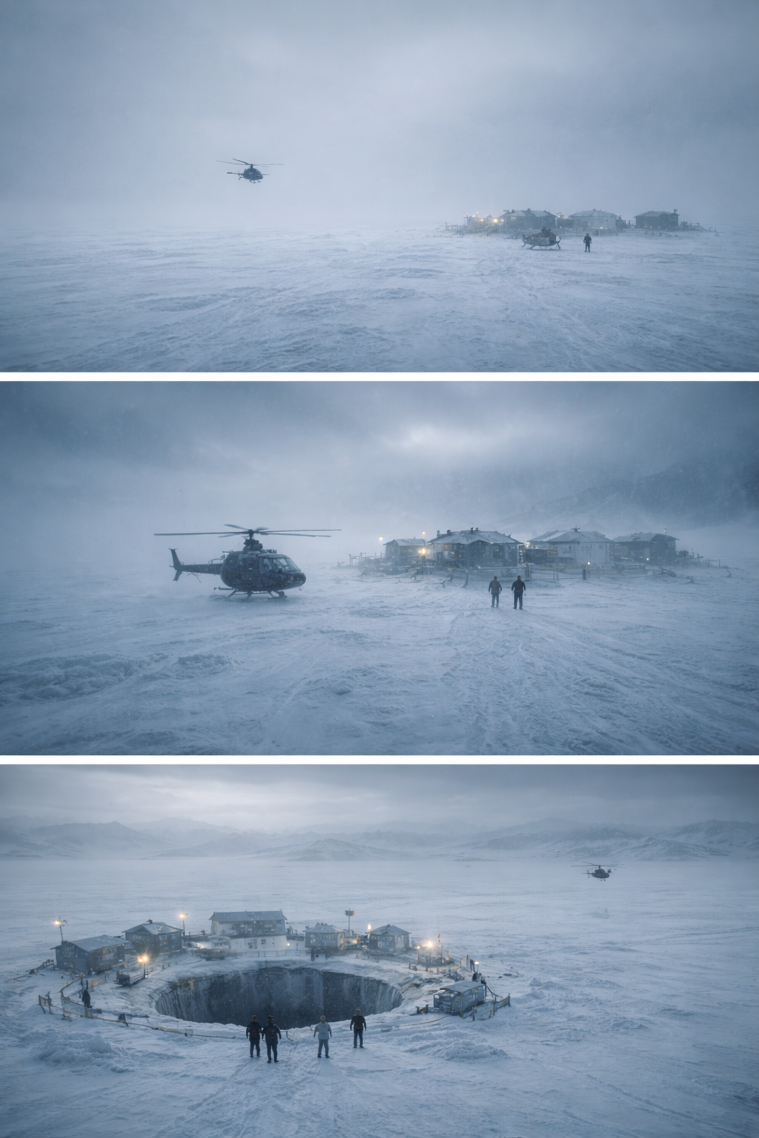
AT THE MOUNTAINS OF MADNESS
Final Director Visual Bible v1 Internal Production Reference PDF
• Built from final v7 screenplay + department policies.
• Purpose: protect tone, visual grammar, and production consistency from prep through post.
AT THE MOUNTAINS OF MADNESS
1/24

Slide 2
How To Use This Bible
• Director/DP: read Framework, Shot Blueprints, key environments, and Entity Rules first.
• Production Design: prioritize Camp/Chamber/Shaft files + spatial/palette diagrams.
• VFX: follow VFX Philosophy + Entity Rules + Chamber/Tunnel/Shaft assets.
• Edit/Sound: use Signature Motifs + Shot Blueprints + Isolation Loop policy.
AT THE MOUNTAINS OF MADNESS
2/24

Slide 3
Global Visual North Star
• Build a controlled, premium cosmic-horror language where revelation is the primary threat vector.
• Horror is epistemic first (what is learned), not attack-driven first (what lunges).
• Visual precision always wins over "cool chaos" or arbitrary spectacle.
• Opening and closing image grammar must mirror each other with a meaning shift.
• Frame humans as small process variables inside large intentional systems.
• Keep geometry readable even in fear-heavy scenes.
• Use silence and low-frequency hum as system-state indicators.
AT THE MOUNTAINS OF MADNESS
3/24

Slide 4
Global Key Frames & Tone Controls
• KF-01: White void aerial, tiny helicopter, distorted signal, no stable orientation.
• KF-02: Corridor contact at Camp D1, wrong-normal order, measured proximity.
• KF-03: Iteration chamber reveal, rows first, people second, meaning last.
• KF-04: Isolationsraum mirror close, pupil shift, procedural dread.
• KF-05: Closing aerial mirror with `STATUS: ITERATION AKTIV`.
• Practical: Snow, wind, camp props, corridor texture, actor-light interaction, near-surface set detail.
• VFX: Depth extension, subtle living-material micro-motion, archive relief activity, scale continuity.
• Exterior: low-contrast cold whites with directional wind streak highlights.
• Camp: practical motivated pools, darker corners that keep geometry intact.
AT THE MOUNTAINS OF MADNESS
4/24

Slide 5
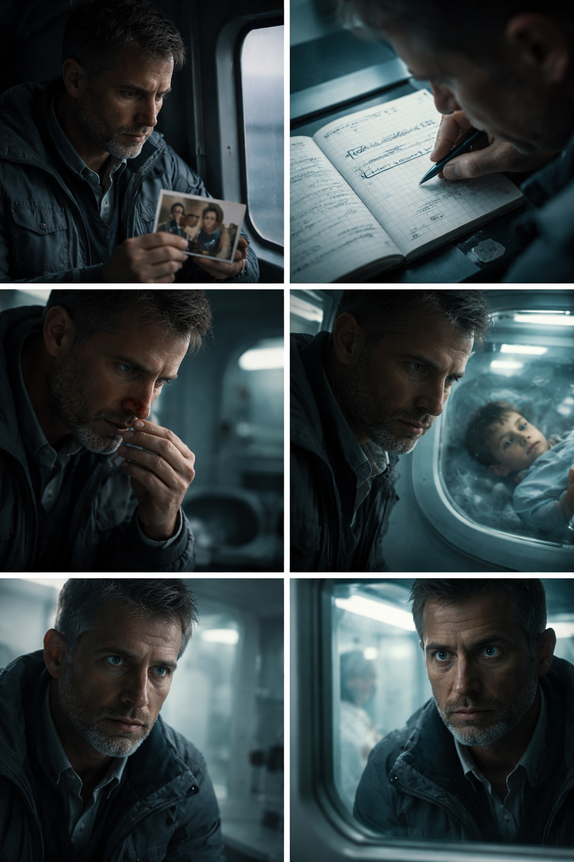
Protagonist Visual: Dr. Elias Keller
• Present Keller as a control-driven scientist whose grief slowly breaks visual certainty.
• Keller never plays as an action hero silhouette.
• Inner conflict must be readable in micro-behavior before dialogue states it.
• His final ambiguity (accepted vs replaced) must remain unresolved visually.
• KF-01: Helicopter interior, photo of son, muted side light.
• KF-02: Notebook insert ("verstehe" crossed into "beweise").
• KF-03: Subtle blood trace after registration moment.
• Act I: neutral cool key, clean facial planes.
• Act II: harder side ratio, deeper orbit shadows under eye.
AT THE MOUNTAINS OF MADNESS
5/24

Slide 6
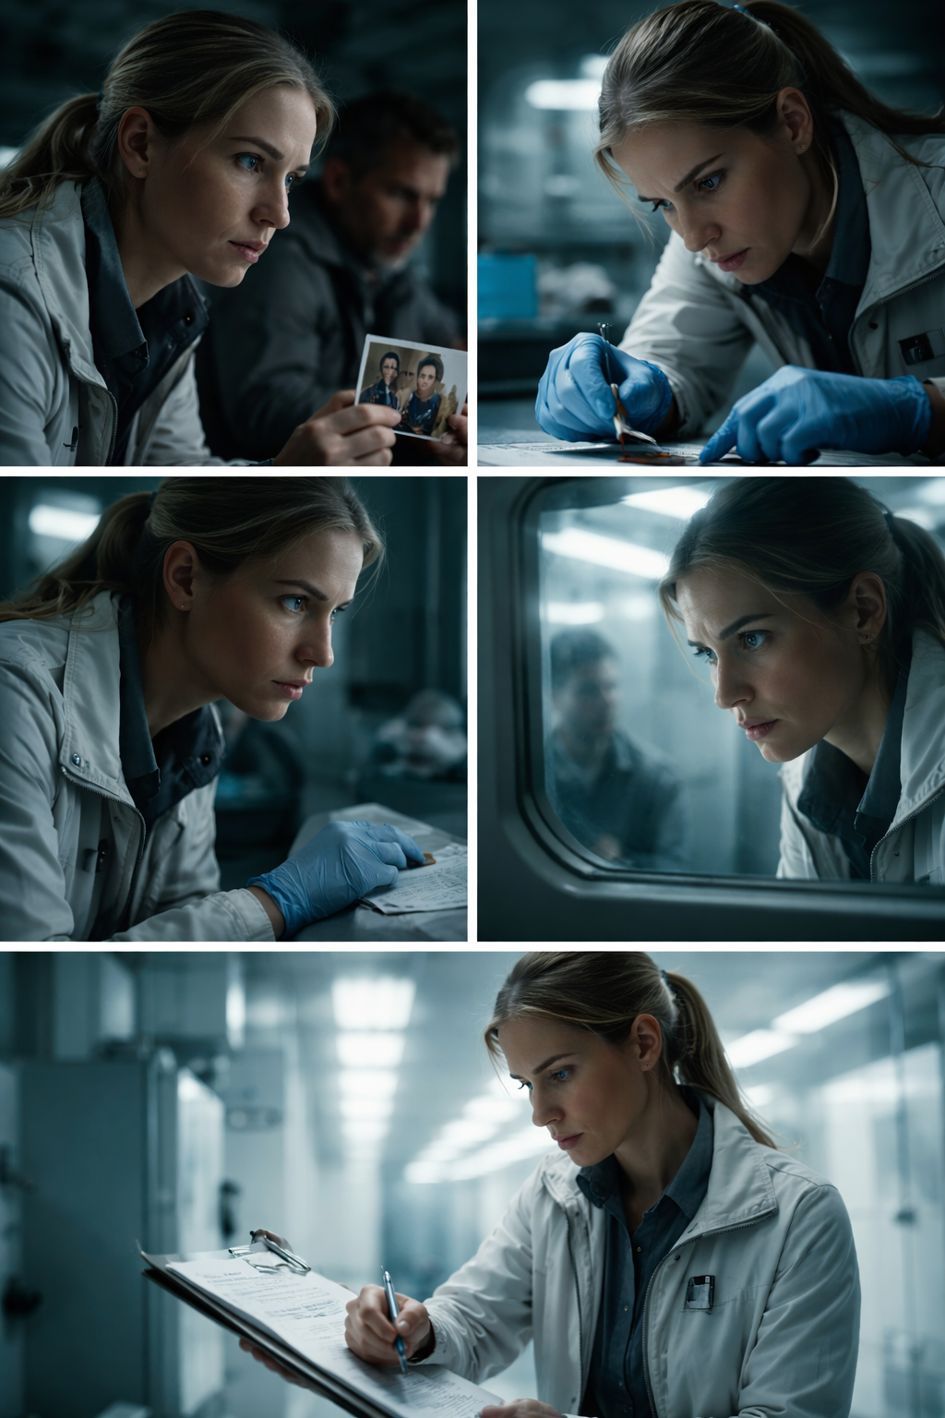
Protagonist Visual: Dr. Lena Hartmann
• Frame Hartmann as the film's ethical optics system, reading risk before others verbalize it.
• Hartmann's authority is observational precision, not volume.
• Her choices must feel active, not reactive.
• She is the first reliable witness of Keller's instability markers.
• KF-01: glance from son photo to Keller.
• KF-02: covert glove bagging after blood trace.
• KF-03: measured look during pupil anomaly.
• Cooler fill values than Keller for objective contrast.
• Side-lit profile in diagnostic scenes to emphasize analytical edge.
AT THE MOUNTAINS OF MADNESS
6/24

Slide 7
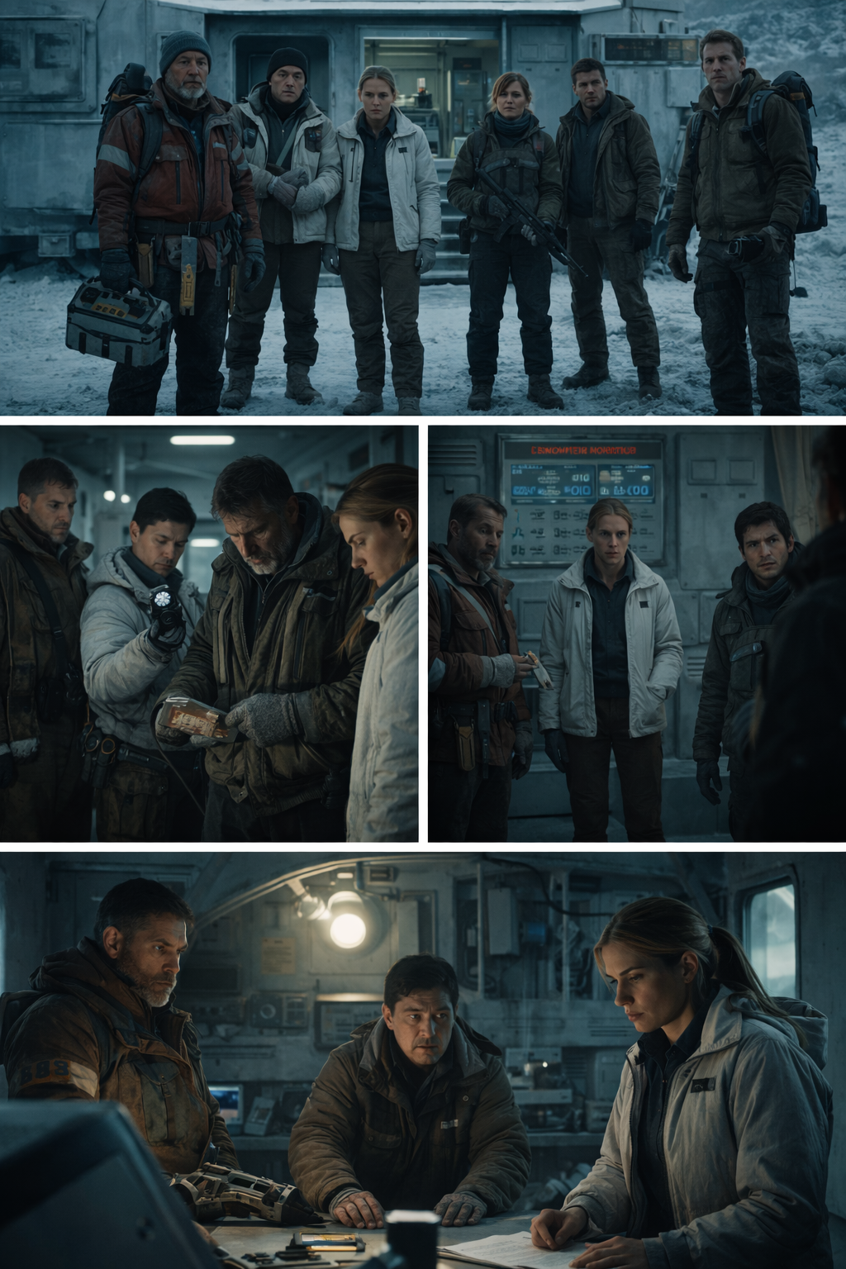
Protagonist Visual: Ensemble Dynamics
• Make each ensemble member visually legible as a distinct survival logic under the same system pressure.
• Ensemble blocking must communicate fracture over time.
• Utility props are identity signals, not decoration.
• Team shape changes after Alvarez loss must be immediately readable.
• KF-01: full six-person configuration at Camp D1 entry.
• KF-02: split attention around corridor contact.
• KF-03: borehole edge debate under weather clock.
• Shared practical key with subtle character-specific edge response.
• More negative fill as hierarchy breaks down.
AT THE MOUNTAINS OF MADNESS
7/24

Slide 8
Environment: Antarctic Surface
• Use the surface world as scale-negation space where humans read as fragile temporary entries.
• Surface frames must communicate orientation loss before threat.
• Helicopter scale must stay modest, never heroic.
• Opening/closing aerial language must match structurally.
• KF-01: opening aerial void with tiny black helicopter.
• KF-02: Camp D1 landing in blown snow haze.
• KF-03: borehole perimeter in low-contrast morning grey.
• Overcast diffuse key, low shadow separation.
• Avoid rich blue skies; preserve muted polar tonality.
• Act I opening: horizon intentionally unstable or absent.
• Mid exterior operational beats: limited horizon return for tactical orientation.
AT THE MOUNTAINS OF MADNESS
8/24

Slide 9
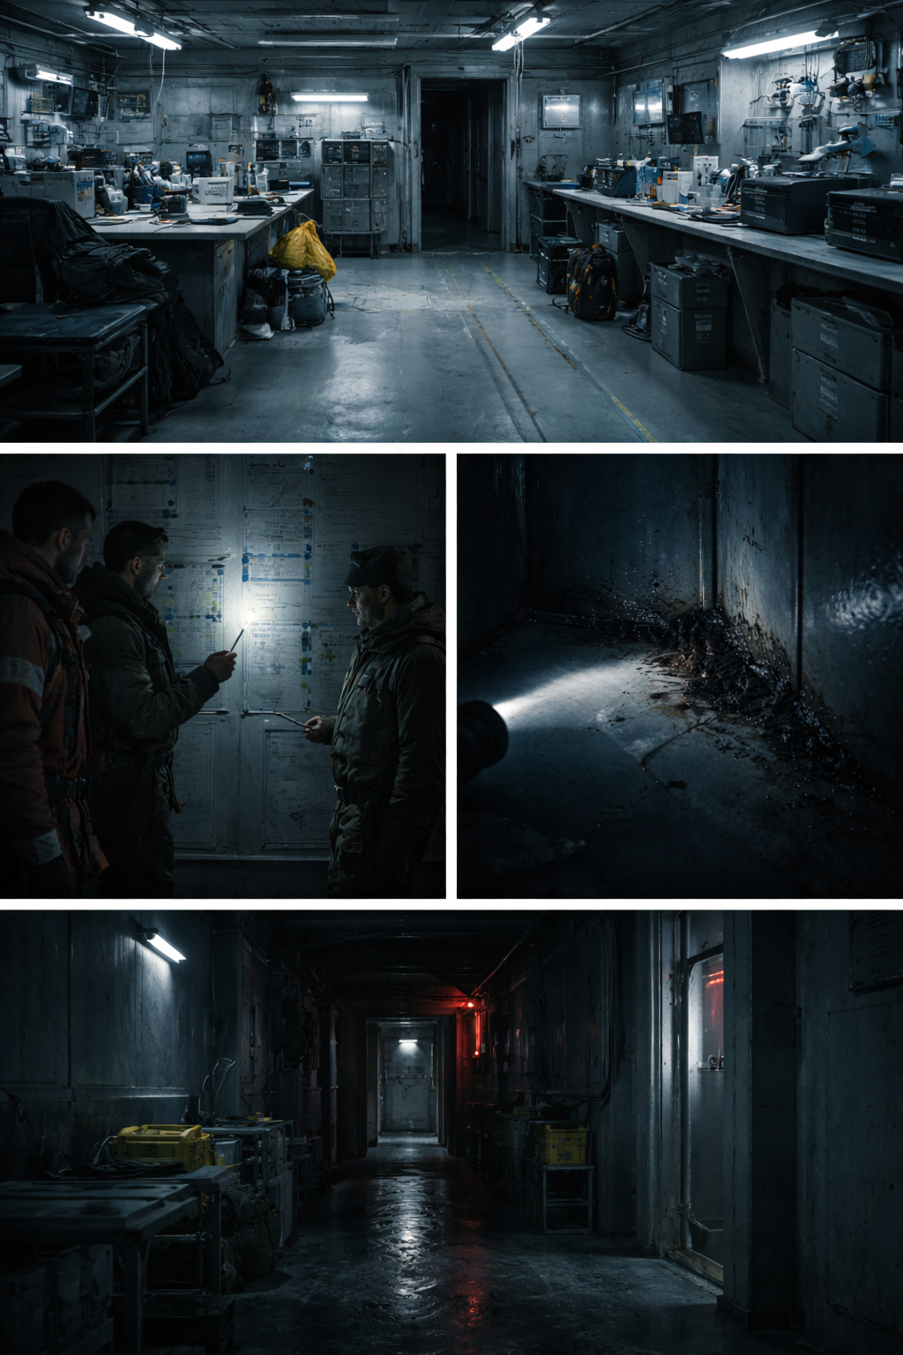
Environment: Camp D1 (Wrong Normal)
• Present Camp D1 as "wrong normal" architecture where procedural order replaces human panic.
• Camp should feel active-adjacent, not abandoned-ruin.
• Every room must imply previous methodical action.
• Corridor contact scene must read as measurement, not attack.
• KF-01: first entry into ordered but empty main module.
• KF-02: wall protocol drawings under controlled flashlight sweep.
• KF-03: black wall substance pulse and retreat.
• Day interiors: practical cool utility lighting with dead zones.
• Night interiors: red-emergency accents plus narrow flashlight keys.
• Cleanly stacked gloves and tools left in usable order.
• Precisely labeled sample containers and marked workstation lines.
AT THE MOUNTAINS OF MADNESS
9/24

Slide 10
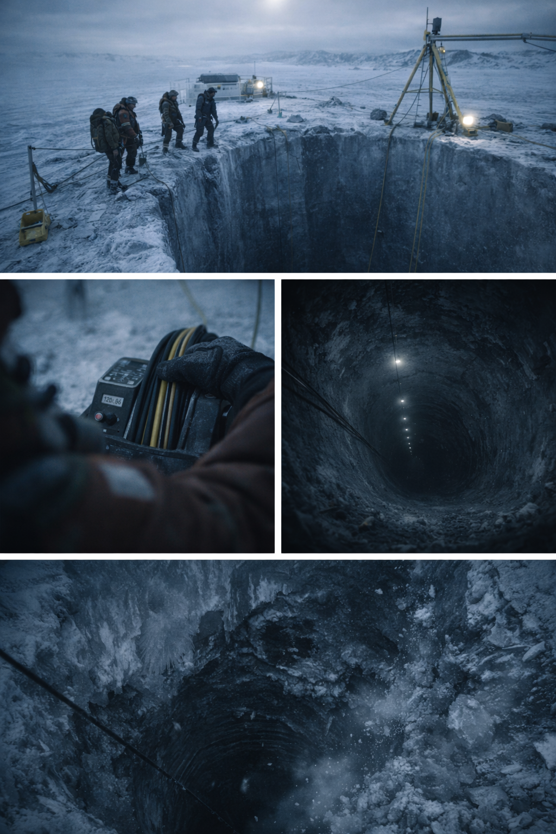
Environment: Borehole + Vertical Shaft
• Make the descent space the physical lock of the narrative where return becomes impossible.
• Verticality must be felt before the collapse happens.
• Point-of-no-return moment must be geographically unambiguous.
• Depth should read as engineered void, not cave randomness.
• KF-01: borehole edge in morning grey with team ring.
• KF-02: cable depth feed with no floor return.
• KF-03: top-down shaft void with diminishing light.
• Surface: overcast diffused light with low-contrast skin rendering.
• Shaft: fast falloff to darkness with practical lamps as depth markers.
AT THE MOUNTAINS OF MADNESS
10/24

Slide 11
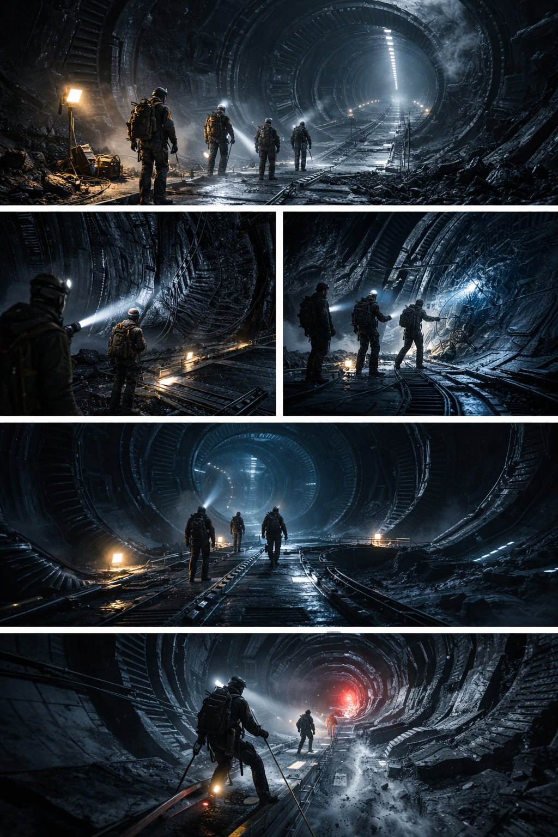
Environment: Alien Structure Tunnels
• Stage the tunnels as active engineered anatomy where space itself performs analysis.
• Tunnel geometry must read intentional and repeatable.
• Material behavior remains subtle, never fantasy-biological spectacle.
• Forward movement should feel like entering a protocol, not exploring ruins.
• KF-01: first tunnel reveal from shaft floor.
• KF-02: moving beam across fibrous black surface.
• KF-03: low-frequency wall response near system event.
• Keep practical beam cones narrow and motivated.
• Preserve heavy negative space without losing orientation.
AT THE MOUNTAINS OF MADNESS
11/24

Slide 12
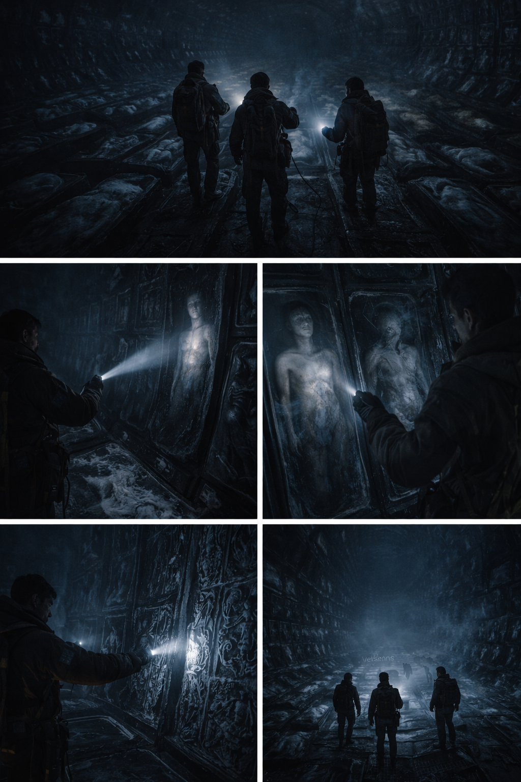
Environment: Iteration Chamber + Archive Wall
• Deliver the film's central ontological shock through controlled visual escalation, not spectacle overload.
• Chamber reveal must be staged in steps, never as one total dump.
• Bodies read as archived series, not gore tableau.
• Archive wall contact is the perception rupture pivot.
• KF-01: rows in darkness before identity recognition.
• KF-02: first clear human silhouette in preserved state.
• KF-03: near-human variation contrast frame.
• Low ambient baseline with hard practical beam sculpting.
• Keep eye adaptation effect through dark-to-detail reveal progression.
• Step 1: Reihen-Geometrie (pattern before meaning).
• Step 2: Menschliche Form (recognition without context).
AT THE MOUNTAINS OF MADNESS
12/24

Slide 13
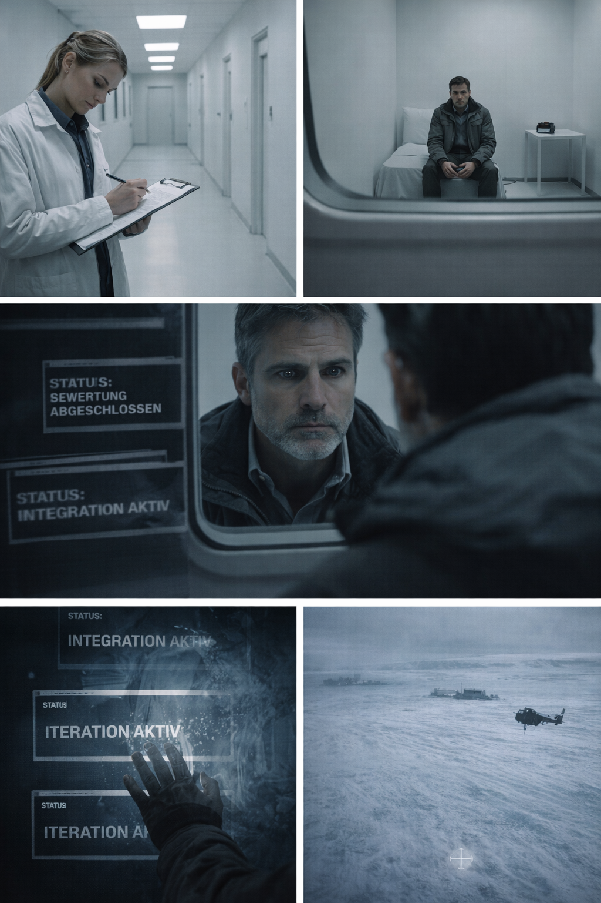
Environment: Isolation + Final Loop
• End with procedural chill where institutional control and cosmic recurrence collapse into one visual statement.
• Isolation spaces must feel administratively clean, not dramatic.
• Final loop must directly echo opening image architecture.
• End cards must read as machine-state communication, not trailer tags.
• KF-01: Hartmann signing institutional statement.
• KF-02: Keller isolated in white room with recorder.
• KF-03: mirror approach and pupil event.
• Corridor: broad flat white with minimal shadow personality.
• Room: similarly flat, with slight eye catchlight control for mirror beat.
• Acoustic bed in isolation scenes should be near-dead.
• Primary audible elements: breath, cloth movement, recorder mechanics.
AT THE MOUNTAINS OF MADNESS
13/24

Slide 14
Shot Blueprint: Opening Aerial / Distorted Signal
• SHOT 01: EXT WIDE aerial / static hold / white void scale cue.
• SHOT 02: EXT WIDE aerial / slow drift / helicopter enters frame as black point.
• SHOT 03: EXT MED long lens / rotor against wind streak / fragility cue.
• SHOT 04: INT cockpit insert / analog signal unit / static begins.
• SHOT 05: INT close on Keller profile / no dialogue / listening state.
• SHOT 06: INT radio speaker macro / distortion texture increases.
• SHOT 07: EXT aerial oblique / horizon instability / orientation loss.
• SHOT 08: INT instrument insert / distorted voice fragment "...Camp D1...".
• SHOT 09: INT reaction split / team silent lock / deep hum enters under noise.
• SHOT 10: EXT transition wide / helicopter continues forward / cut to Camp D1 approach.
AT THE MOUNTAINS OF MADNESS
14/24

Slide 15
Shot Blueprint: Vertical Shaft Collapse
• SHOT 01: EXT top-down wide / full team at borehole edge / rope and marker visibility.
• SHOT 02: INSERT cable monitor / depth feed unstable / no floor return.
• SHOT 03: POV down shaft / beam swallowed by darkness.
• SHOT 04: MED on descent team / rope tension increases.
• SHOT 05: INSERT anchor hardware / micro-vibration and ice crack.
• SHOT 06: CLOSE Baranov/Sato / recognition beat before failure.
• SHOT 07: EXT edge profile / structural shear and ice plate break.
• SHOT 08: WIDE collapse read / entry geometry changes clearly.
• SHOT 09: CLOSE on blocked rim / debris lock / "return path gone" clarity.
• SHOT 10: MED Keller command beat / forward-only decision.
AT THE MOUNTAINS OF MADNESS
15/24

Slide 16
Shot Blueprint: Iteration Chamber Reveal
• SHOT 01: TUNNEL EXIT wide / chamber darkness with row hints only.
• SHOT 02: MED move-in / beam cuts first line geometry (pattern before identity).
• SHOT 03: INSERT silhouette in frost / first human form recognition.
• SHOT 04: REACTION close Keller/Hartmann / cognitive hesitation.
• SHOT 05: lateral pass / near-human variation appears in same row logic.
• SHOT 06: WIDE depth read / serial structure extends beyond visibility.
• SHOT 07: CLOSE on son-like profile in chamber / denial beat.
• SHOT 08: TRACK to archive wall / surface relief starts micro-response.
• SHOT 09: HAND CONTACT insert / wall activation and hum shift.
• SHOT 10: SUBJECTIVE rupture montage / data not image.
• SHOT 11: RETURN WIDE / team scale collapses against chamber scale.
• SHOT 12: ENTITY threshold frame / measured presence, not attack posture.
AT THE MOUNTAINS OF MADNESS
16/24

Slide 17
Signature Motifs Continuity Matrix
• Son photo -> Helicopter intro (`#2`) -> From memory object to proof-obsession trigger -> Son-like chamber iteration (`#23`/`#24`)
• Notebook / protocol writing -> Early control behavior (`#2`) -> Control turns into compulsive evidence logic -> Institutional-end ambiguity frame (`#34`)
• Cyan measurement accent -> Camp diagnostics (`#7`, `#14`) -> Device readout to system-response marker -> Integration process coding in end status logic
• Mirror image -> Isolation room setup (`#34`) -> Identity confidence rupture via pupil event -> Replacement question unresolved in final beat
• Status cards -> Institutional process layer (`#34`) -> Human report frame collapses into machine process frame -> `STATUS: ITERATION AKTIV` (`#35` ending)
• Distorted signal + deep hum -> Opening unknown cue (`#1`/`#2`) -> Reframed as active system communication -> Closing mirror confirms cycle recurrence
AT THE MOUNTAINS OF MADNESS
17/24

Slide 18
VFX Philosophy Policy (Practical-First)
• Protect the film's clinical tone by defining where VFX serves story precision and where it is explicitly constrained.
• Practical-first execution in all actor-proximate zones.
• VFX is a scale and continuity tool, not a style replacement engine.
• Every VFX event must preserve geographic readability and tonal restraint.
• Use practical snow/wind/props and near-surface structure texture as baseline reality.
• Reserve VFX for depth, extension, subtle system behavior, and continuity stitching.
• Enforce early asset lock and shot-level intent notes before vendor turnarounds.
• Practical:
• Snow, wind, rotor interaction, costume contamination, hero props.
AT THE MOUNTAINS OF MADNESS
18/24

Slide 19
Entity Behavior Rule Set
• Define strict behavior grammar so entities remain procedural intelligences, not monster antagonists.
• Entities are evaluators/operators, never rage-driven hunters.
• Movement reads measured and purposeful at all times.
• Interaction priority is sensing/comparing/classifying, not killing.
• Zone 1 — Observe (>6m): silhouette + hum presence, no rush, no escalation.
• Zone 2 — Measure (2–6m): slow calibrated approach, one or two purposeful stops.
• Zone 3 — Contact (<2m): sensor/forehead contact → immediate processing stillness → disengage.
• Stage entity beats as controlled interventions with clear operational intent.
• Keep distance logic consistent (observe -> approach -> measure -> disengage).
• Use silence and low-frequency system tones as primary presence cues.
AT THE MOUNTAINS OF MADNESS
19/24

Slide 20
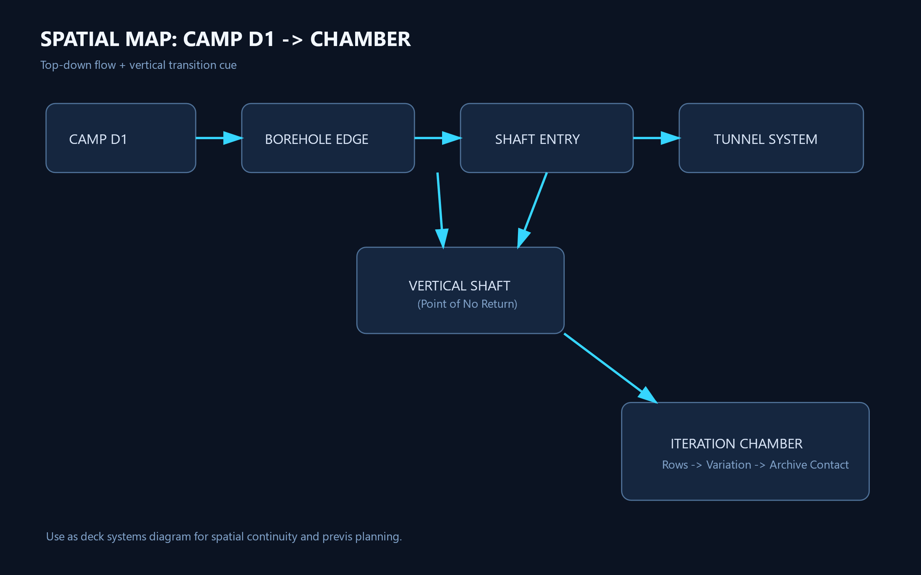
Diagram: Spatial Map (Camp to Chamber)
Top-down + vertical continuity map for previs and set geography validation.
AT THE MOUNTAINS OF MADNESS
20/24

Slide 21
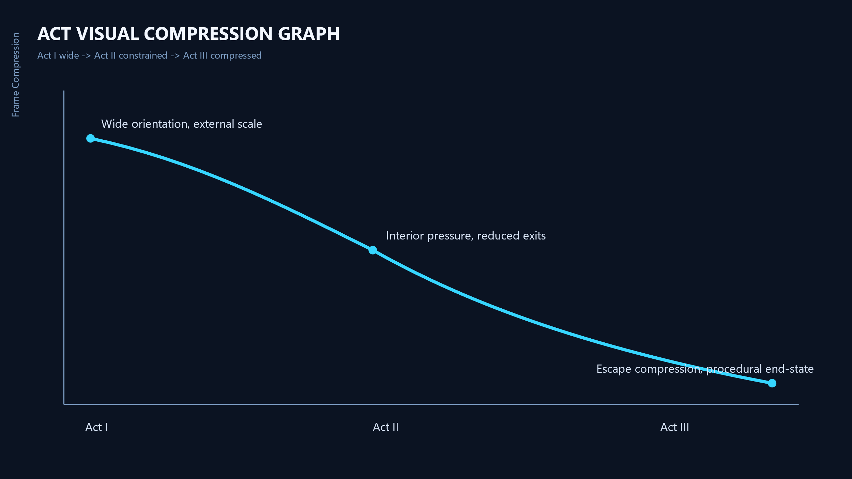
Diagram: Act Visual Compression
Act I wide to Act III tight framing policy.
AT THE MOUNTAINS OF MADNESS
21/24

Slide 22
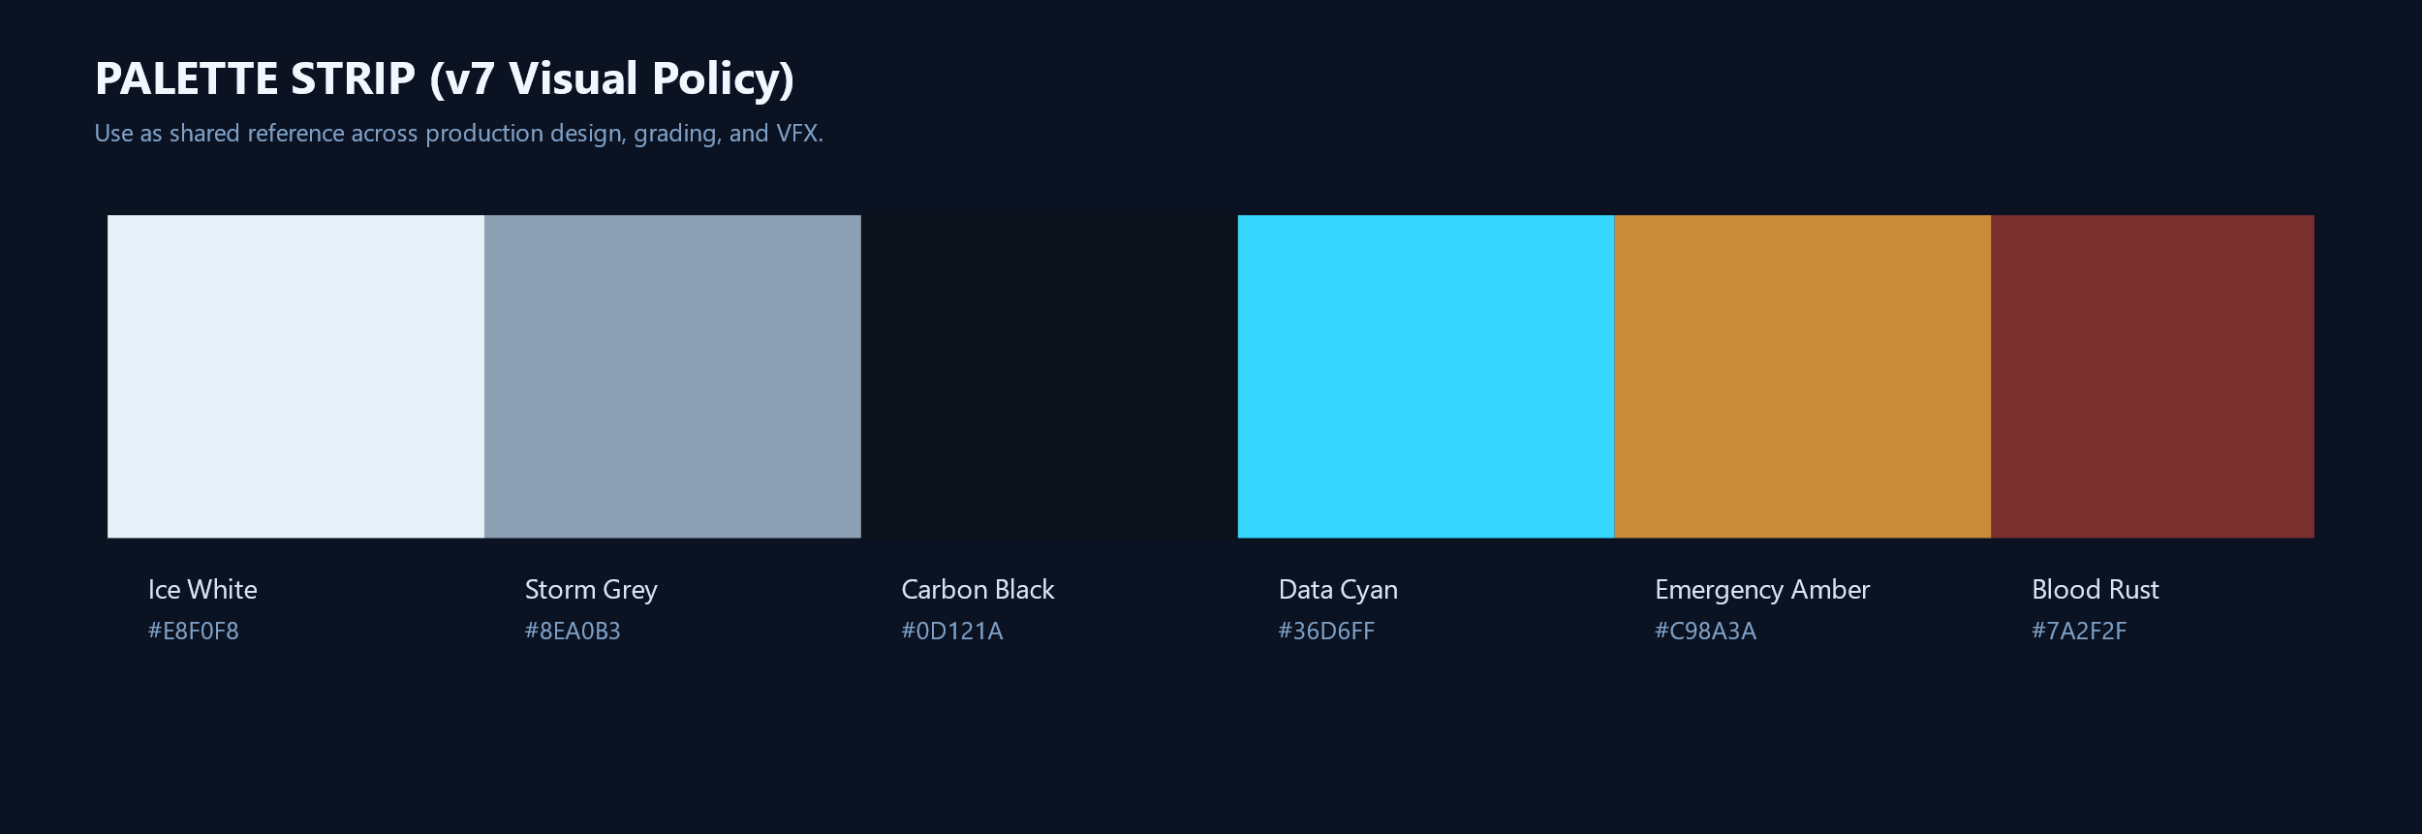
Diagram: Master Palette Strip
Cross-department palette lock for production design, grading, and VFX.
AT THE MOUNTAINS OF MADNESS
22/24

Slide 23
Appendix: Department File Map
• Director/DP: 00, 20, 11-16, 23, compression diagram.
• Production Design: 12-16, spatial map, palette strip.
• VFX: 22, 23, 13-15.
• Edit/Sound: 21, 20, 16, 23.
AT THE MOUNTAINS OF MADNESS
23/24

Slide 24
Final Note
• This bible is a drift-control system: tone, scale, and behavior must stay coherent from prep to final mix.
• If a choice increases spectacle but reduces meaning clarity, reject it.
STATUS: ITERATION AKTIV
AT THE MOUNTAINS OF MADNESS
24/24

